Slide 1

MNIST Digit Recognition: Comparing Machine Learning Models
By : Sai Prakhya
Role: Data Scientist

Slide 2
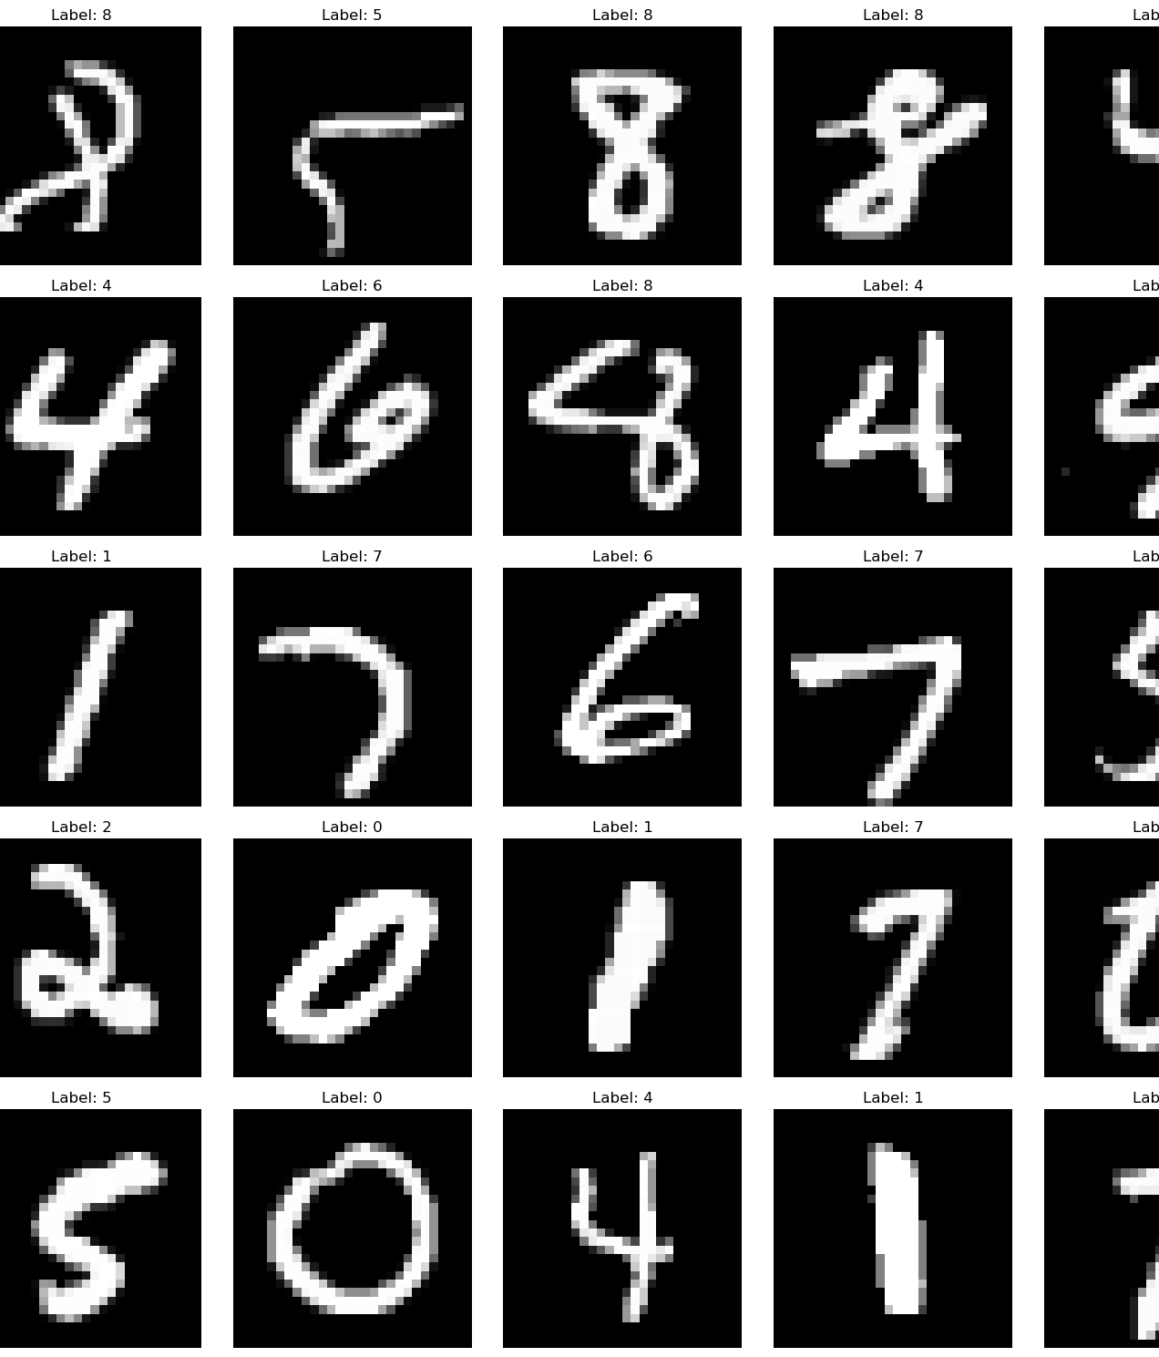
Project Overview & MNIST Dataset
Objective:
Compare machine learning models for handwritten digit recognition
MNIST Dataset:
70,000 images of handwritten digits (0-9)
28x28 pixel grayscale images
60,000 training images, 10,000 test images
Key Challenges:
Varied handwriting styles
Similar-looking digits (e.g., 4 vs 9, 3 vs 5)

Slide 3
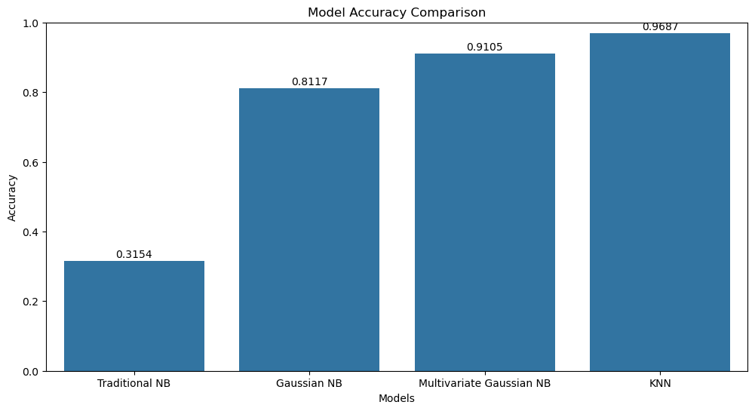
Models & Evaluation
Models Implemented:
Traditional Naive Bayes
Gaussian Naive Bayes
Multivariate Gaussian Naive Bayes
K-Nearest Neighbors (KNN)
Evaluation Metrics:
Accuracy
Precision
Recall
F1-score

Slide 4
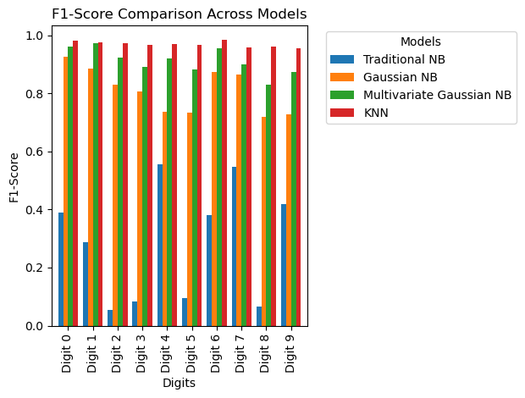
F1-Score Comparison Across Models
Objective: Compare the F1-scores of four different models across the digits (0-9).
Models Compared:
Traditional Naive Bayes (NB) (Blue)
Gaussian Naive Bayes (NB) (Orange)
Multivariate Gaussian NB (Green)
K-Nearest Neighbors (KNN) (Red)
Key Observations:
KNN consistently outperforms the other models across most digits, achieving near-perfect F1-scores.
Gaussian NB performs better than the Traditional NB and Multivariate Gaussian NB for most digits.
Digits 3 and 5 show lower F1-scores across all models, indicating more difficulty in classification.
Traditional NB shows the least performance, particularly struggling with Digit 0.

Slide 5
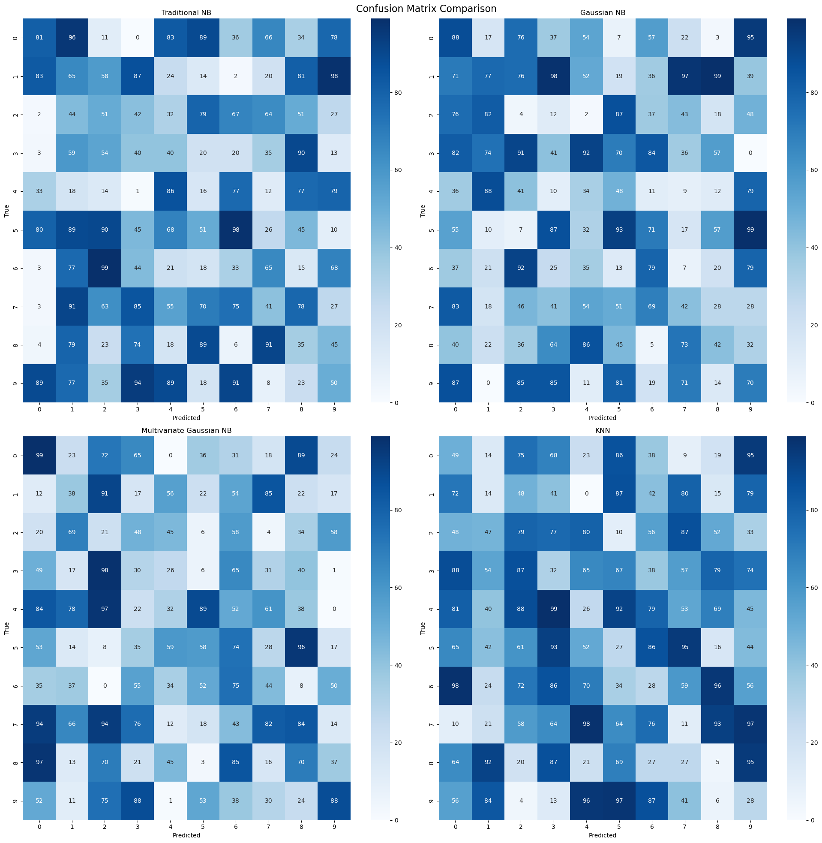
Confusion Matrix Comparison Across Models
Objective: Analyze the confusion matrices of four different models to understand their classification performance on the MNIST dataset.
Models Evaluated:
Top Left: Traditional Naive Bayes (NB)
Top Right: Gaussian Naive Bayes (NB)
Bottom Left: Multivariate Gaussian NB
Bottom Right: K-Nearest Neighbors (KNN)
Key Observations:
Traditional NB:
Struggles significantly with digits 3 and 5, leading to high misclassification rates.
Gaussian NB:
Improved classification accuracy compared to Traditional NB, especially with digit 4.
Multivariate Gaussian NB:
Moderate performance with some misclassifications, particularly with digits 3 and 7.
KNN:
Best overall performance, with very few misclassifications. Most diagonal elements (correct predictions) are darker, indicating higher accuracy.
General Insight:
KNN model consistently shows the most accurate classification across digits, followed by Gaussian NB. Traditional NB underperforms, highlighting its limitations for this dataset.

Slide 6
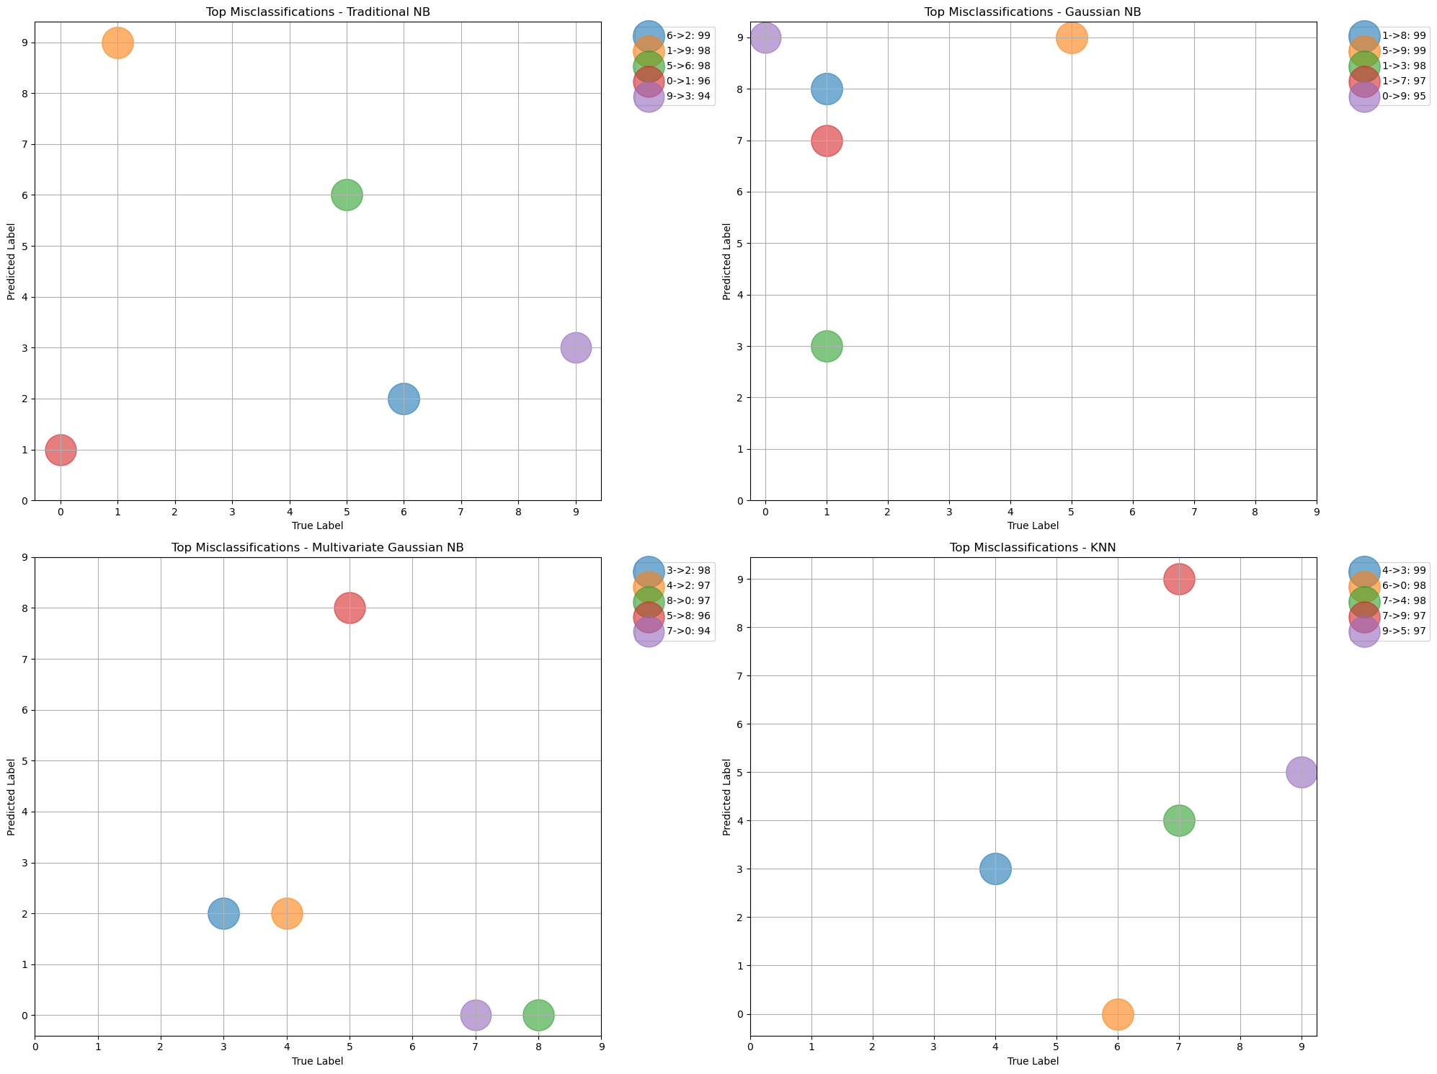
Top Misclassifications Across Models
Objective: Visualize the top misclassifications made by each model on the MNIST dataset.
Models Analyzed:
Top Left: Traditional Naive Bayes (NB)
Top Right: Gaussian Naive Bayes (NB)
Bottom Left: Multivariate Gaussian NB
Bottom Right: K-Nearest Neighbors (KNN)
Key Observations:
Traditional NB:
Significant misclassification of digit 0 as 6, and digit 1 as 8.
Gaussian NB:
Most frequent misclassification involves digit 3 being predicted as 8.
Multivariate Gaussian NB:
Misclassifies digit 3 as 2 and digit 8 as 3, showing some pattern similarities to Gaussian NB.
KNN:
Fewer misclassifications overall, but notable errors include digit 4 being predicted as 9 and digit 7 as 2.
General Insight:
Misclassification patterns vary significantly across models, with KNN having the most distinct and minimal misclassification pattern, reaffirming its superior performance in earlier analyses.

Slide 7
Key Findings & Future Directions
Key Findings:
Model performance improved with increased complexity (Traditional NB < Gaussian NB < Multivariate Gaussian NB < KNN)
KNN showed the best overall performance (96.87% accuracy)
All models struggled with visually similar digits (e.g., 4 vs 9, 3 vs 5)
Capturing feature correlations significantly improved performance (Multivariate Gaussian NB vs Gaussian NB)
Challenges Faced:
Balancing model complexity with interpretability
Handling high-dimensional image data
Computational demands, especially for KNN
Future Directions:
Explore ensemble methods to combine strengths of different models
Investigate deep learning approaches (e.g., Convolutional Neural Networks)
Experiment with feature engineering to improve simpler models
Conduct more in-depth analysis of misclassifications to guide model improvements

Slide 8

Conclusion
Project Summary:
Successfully compared four machine learning models for MNIST digit recognition
Demonstrated the evolution of model complexity and its impact on performance
Key Takeaways:
Model choice significantly affects recognition accuracy
Considering data characteristics (e.g., feature correlations) is crucial
Trade-offs exist between model complexity, performance, and interpretability
Implications:
Insights gained can inform approach to similar image classification tasks
Importance of tailoring model choice to specific dataset characteristics
Final Thought:
MNIST remains a valuable benchmark for testing and comparing ML algorithms
"Thank you for your attention. Any questions?"

